Slide 1
Dwarf Galaxies on fire
Alex Fitts
UT theory seminar 4/25/16

Slide 2
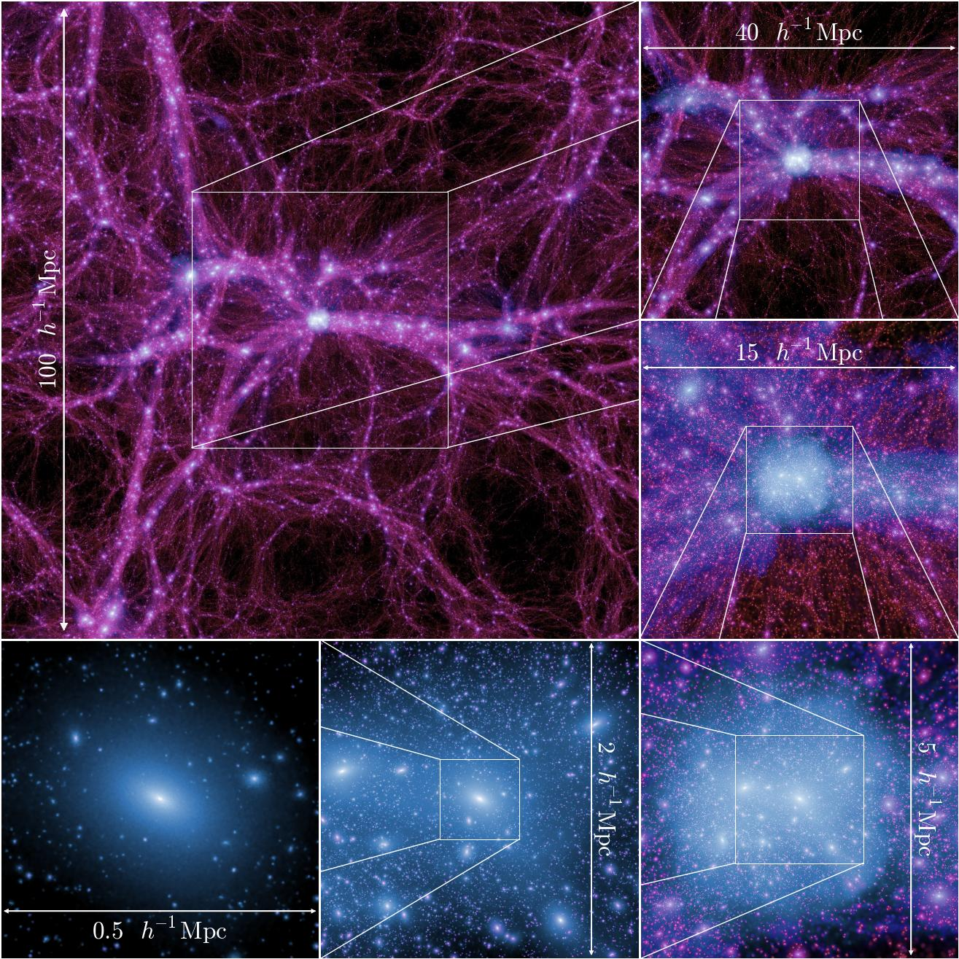
Boylan-Kolchin et al. 2009
Notes:
----- Meeting Notes (4/25/16 01:06) -----
In the standard cold dark matter (CDM) paradigm, the formation of galaxies is driven by the large-scale stucture of the universe and the formation of dark matter halos. Galaxies form by the c ooling and condensation of gas in the centers of the potential wells of extended virialized dark matter halos. in this picture, glaxy properties, such as luminosity or stellar mass, are expected to be tightly couple to th depth of the halo potential and thus to the mass.

Slide 3
Somerville 2015
Notes:
----- Meeting Notes (4/25/16 10:02) -----
Dwarfs are interesting because they have shallow potential wells and are therefore sensitive to both stellar feedback and UV background feedback
10^10 M_sun is about the halo mass of a typical dwarf with stellar mass of 1e6 in current models.

Slide 4
Small scale issues
Missing Satellites
Core/cusp
Too-Big-to-Fail (TBTF)

Slide 5
Small scale issues
Missing Satellites
Core/cusp
Too-Big-to-Fail (TBTF)

Slide 6
Kravtsov et al. 2010
Notes:
----- Meeting Notes (4/25/16 01:24) -----
Cumulative circular velocity function

Slide 7
Small scale issues
Missing Satellites
Core/cusp
CDM simulations predict a universal NFW ‘cuspy’ profile,
Observe ‘cores’ with
Too-Big-to-Fail (TBTF)
Notes:
----- Meeting Notes (4/25/16 00:43) -----
Rotation curves of LSB and late-type, gas-rich dwarf galax- ies indicate the presence of constant-density or mildy cuspy (α ∼ −0.2) dark matter cores, contradicting the predictions of cosmological simulations. The most recent simulations still indicate resolved mass density slopes that are too steep to be easily reconciled with the observations (typically α ∼ −0.8 at a radius ∼ 0.1 kpc). Claims of shallow slopes at even smaller radii depend on the validity of the analytical description cho- sen for the mass-density profile.

Slide 8
Small scale issues
Missing Satellites
Core/cusp
Too-Big-to-Fail (TBTF)

Slide 9
Boylan-Kolchin et al. 2012

Slide 10
M_{halo} ~ 10¹⁰ M = Key mass scale
Perfect range to test whether baryonic physics can alleviate the TBTF problem.
Important threshold to understand what drives core formation in halos.

Slide 11
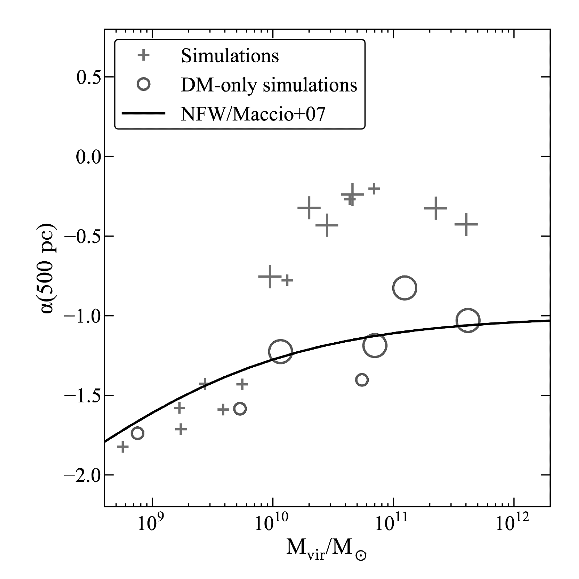
Governato et al. 2012

Slide 12
My simulations
GIZMO MFM code
FIRE feedback suite
10 isolated dwarfs at M_{halo}~10¹⁰ M + 1 ultra-faint
Range of assembly histories
ε_{gas}~ 1.4 pc ε_{dm}~25 pc
M_{gas}~ 200 M, M_{dm}~ 2500 M
25³ Mpc³ box
Effective resolution of 2 x 8192³ particles
Notes:
----- Meeting Notes (4/24/16 22:44) -----
Explain isolation criteria.
Explain zoom in techinique.
----- Meeting Notes (4/25/16 10:19) -----
halos at z=0 have on the order of 1e6 dm particles and 1e4 star particles

Slide 13
M* vs R_{1/2}

Slide 14
Vs observation
Oñorbe et al. 2015

Slide 15
M_{dyn} vs r_{1/2}

Slide 16
Vs observation
Oñorbe et al. 2015

Slide 17
Simulated Star formation histories

Slide 18
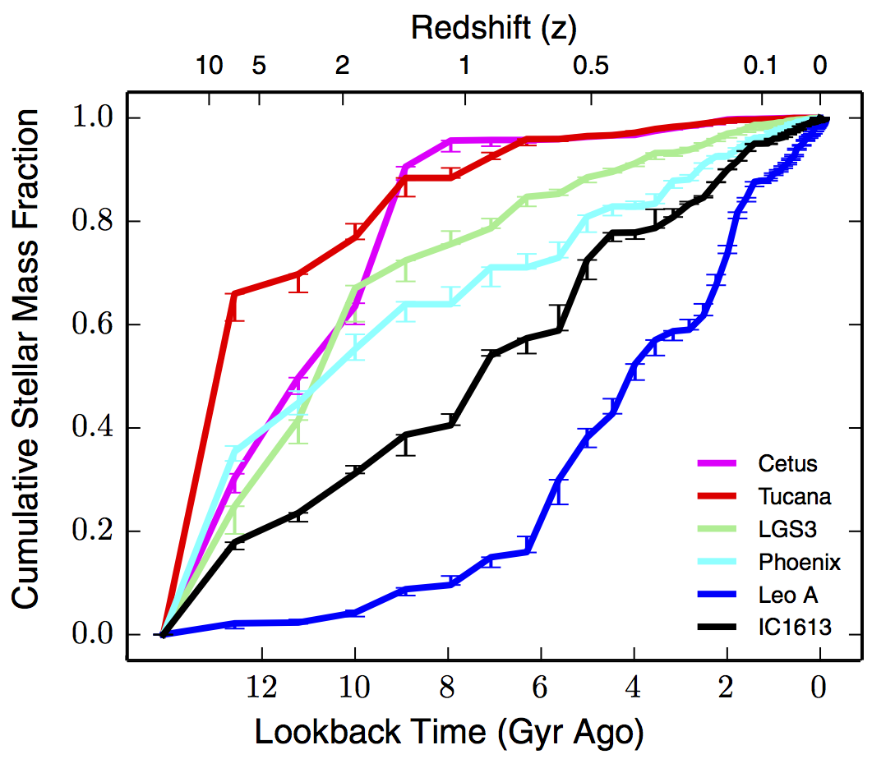
Observed star formation histories
Skillman et al. 2014

Slide 19
Core formation

Slide 20
Cusps as well

Slide 21
Core/cusp

Slide 22
rho_{core} vs r_{half}

Slide 23
rho_{core} vs M*

Slide 24
Future work
Quenched vs Active Star formation
What forms cores?
vs WDM, SIDM
Reionization’s impact on ultra-faint galaxies

Slide 25
extras

Slide 26
Bursty Star formation rate

Slide 27
Gas shells throughout time

Slide 28
TBTF

Slide 29
Penarrubia et al. 2012
Notes:
----- Meeting Notes (4/24/16 23:11) -----
Red shaded region = energy to form a core
Black dots = 1kpc
Right axis is luminosity derived from a star formation efficiency tuned to reproduce the number of luminous satellites in our Galaxy. SNeII energy.

